Slide 1
Empowering Kubernetes with Cilium: Beyond Traditional Networking
Abraham Alfaro
Cloud Engineer @ AWS

Slide 2

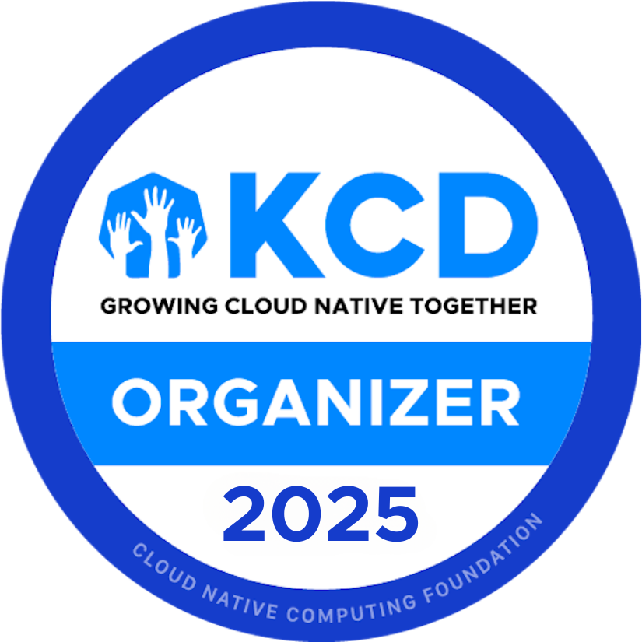
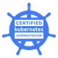
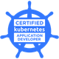
Who am I
Abraham Alfaro
Cloud Engineer @ AWS

Slide 3

Agenda
Kubernetes architecture
Networking in Kubernetes
Introduction to Cilium
Core Components & Architecture
Key Features
Implementation
Demo/Hands-on
QA

Slide 4
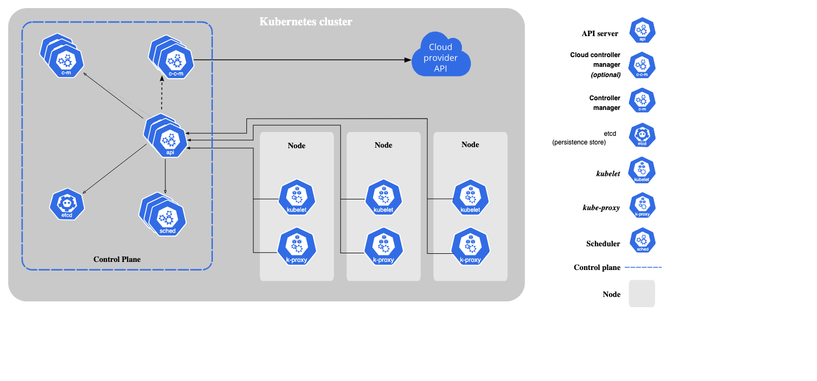

Slide 5
Networking in Kubernetes
Container to container communication.
Pod to pod communication.
Pod to service communication.
External communication (ingress and egress)

Slide 6
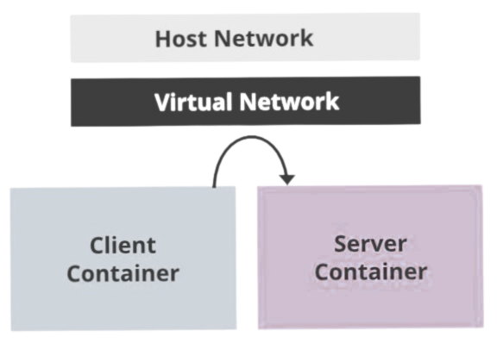
Container to container communication
Containers use localhost
Pod = network NS, IP and port space

Slide 7
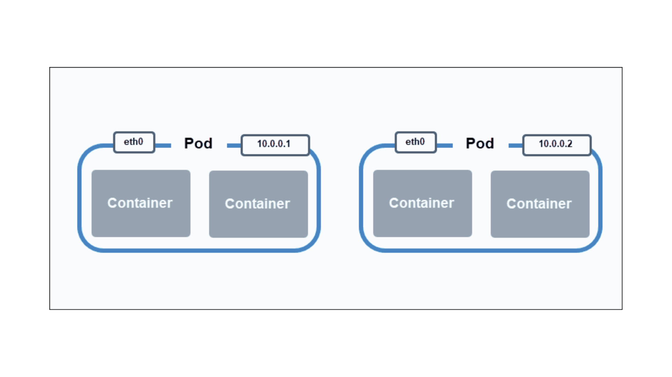
Pod to pod communication

Slide 8
Pod to service communication
A Kubernetes service maps a single IP address to a pod group to address the issue of a pod's changing address. The service creates a single endpoint, an immutable IP address and hostname, and forwards requests to a pod in that service.
The kube-proxy process runs in every node, mapping a service's virtual IP addresses to pod IP addresses. Services enable implementing load balancing techniques and exposing a deployment for external connections.

Slide 9
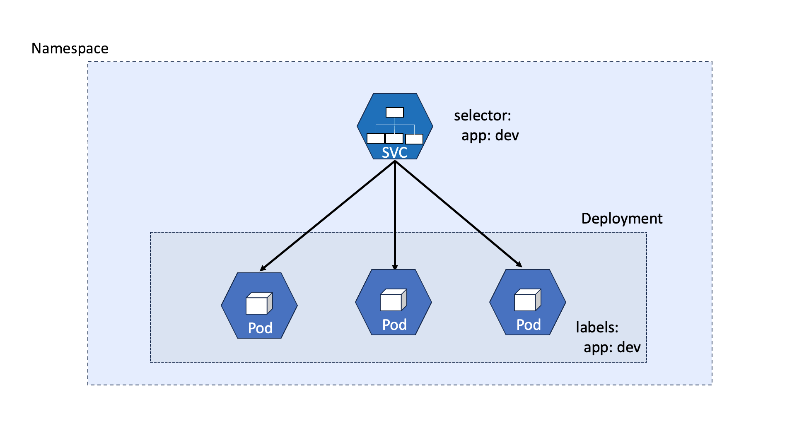

Slide 10
External communication
Egress:
iptables: source Pod IP -> internal node/VM ip
Internet Gateway for NAT -> internal VM IP -> public node IP
Ingress:
LoadBalancer service - external IP
Ingress and ingress controller for routing to correct service

Slide 11
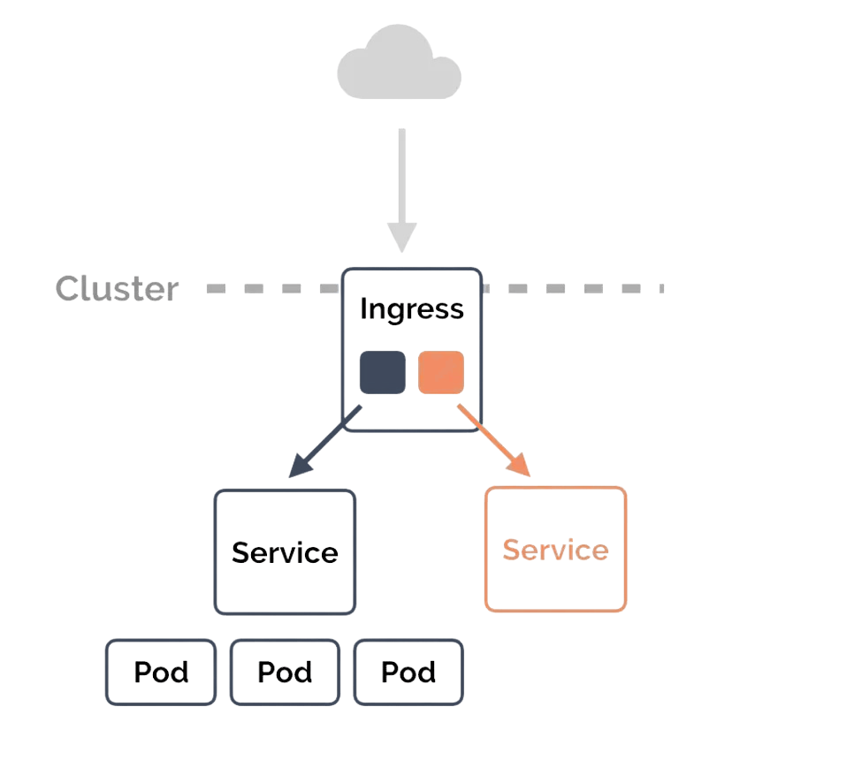
Ingress

Slide 12
Kube proxy
Runs on every node
Keeps services and endpoints (pod IPs) up to date
Manages routing rules on the nodes
Four modes:
userpace
kernelspace
iptables
ipvs (IP virtual server)

Slide 13
Container Network Interface (CNI)
Component between the container runtime and network implementation
CNI plugins called whenever a container gets created/removed
Responsible for:
IPAM (IP address management)
Setting up routes
Examples:
Cilium,Calico, Flannel, AWS VPC CNI, Azure CNI, etc.

Slide 14
CNI Spec
Contract between CRI and CNI plugin
ADD | Adds a container to the network, returns the created interfaces/IPs
DELETE | Removes a container from the network, releases resources
CHECK | Checks whether the container network is set up properly
VERSION | Returns CNI versions supported by the plugin

Slide 15

What is Cilium?
Cilium is a cloud native solution for providing, securing and observing network connectivity between workloads, by the revolutionary Kernel technology eBPF.

Slide 16


Slide 17
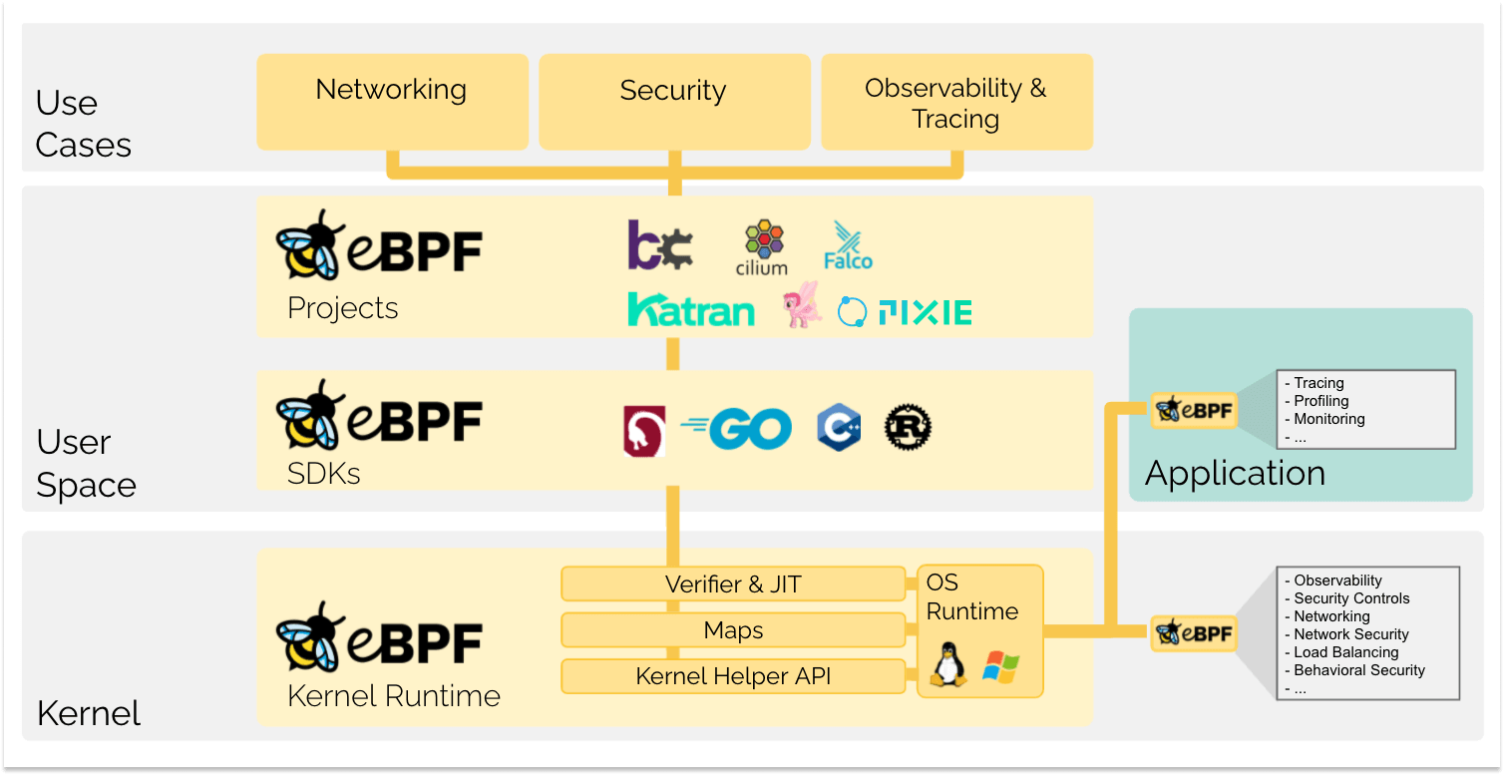

Slide 18
Notes:
https://docs.cilium.io/en/stable/overview/component-overview/

Slide 19
Components
Cilium daemon
Cilium CLI Client
Cilium Operator
CNI Plugin
eBPF
Data Store
Notes:
https://www.tigera.io/learn/guides/cilium-vs-calico/cilium/

Slide 20
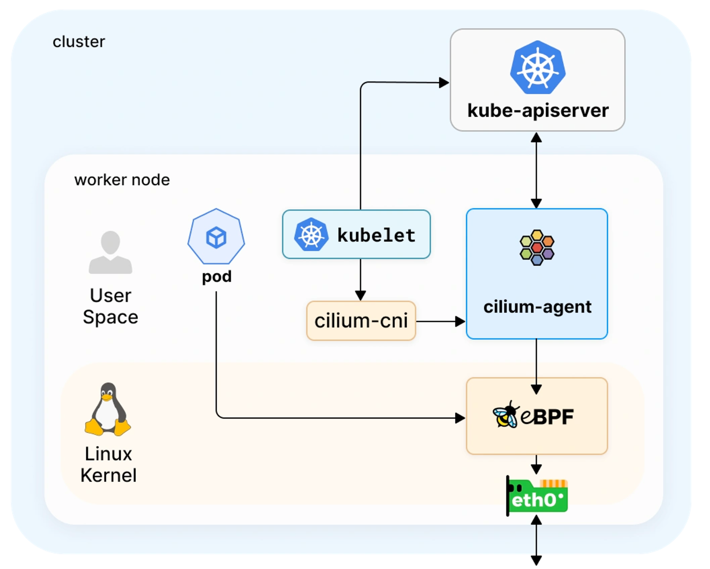

Slide 21
Cilium features
Connecting workloads
Flat L3 network and overlay networking model
Enforcing network policies
NetworkPolicy ir CiliumNetworkPolicy
Uses Envoy for L7 path
Visualizing network traffic flows
Hubble
Prometheus metrics
- Encryption using IPSec or Wireguard

Slide 22
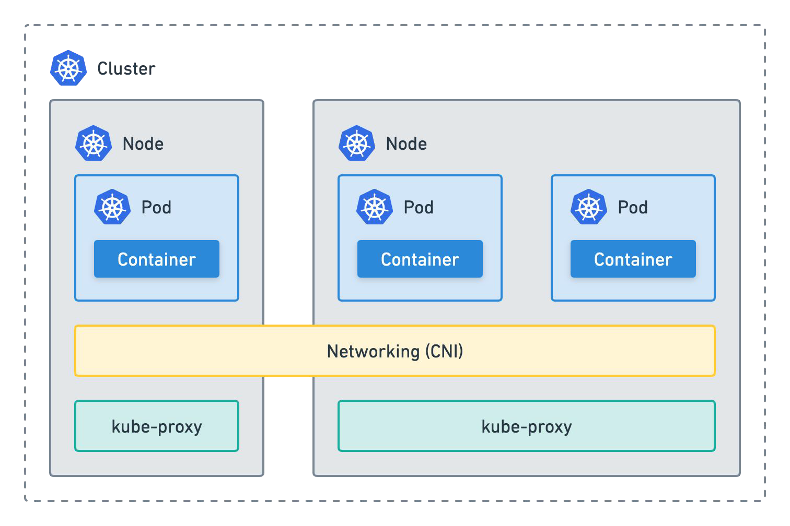
Kubernetes networking
IPAM
Kube Proxy
Services
Iptables or ipvs
Service discovery

Slide 23
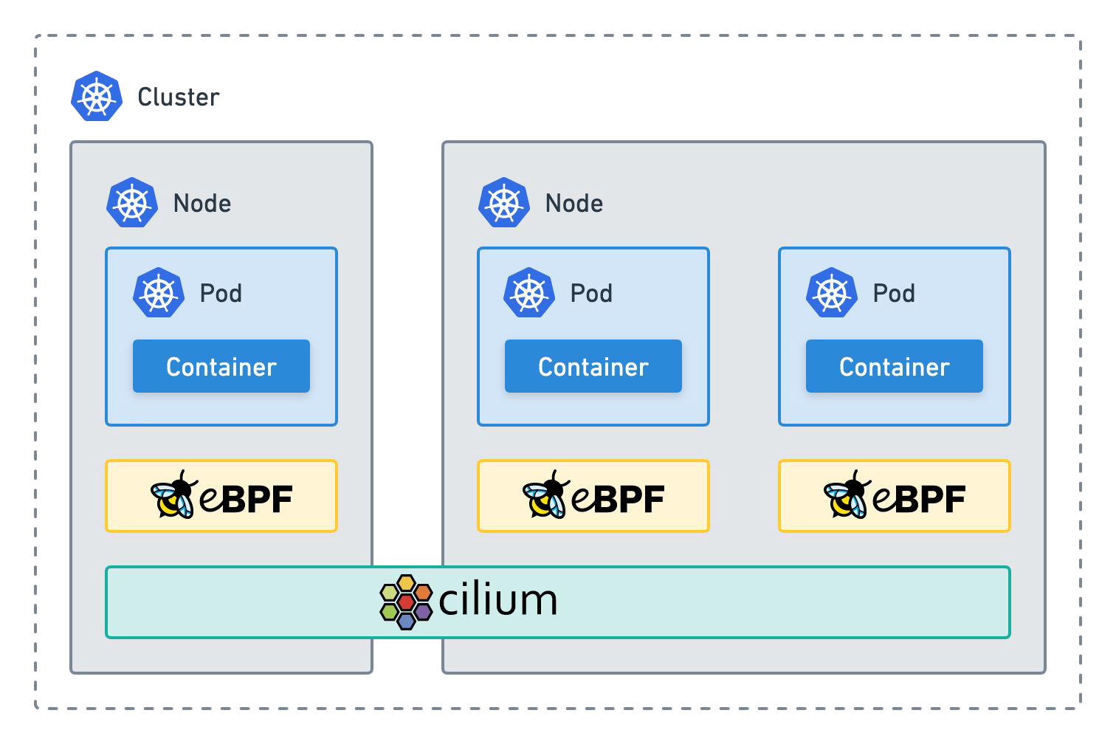
Kubernetes networking
eBPF native dataplane
Kube-proxy replacement
Agent on each node

Slide 24
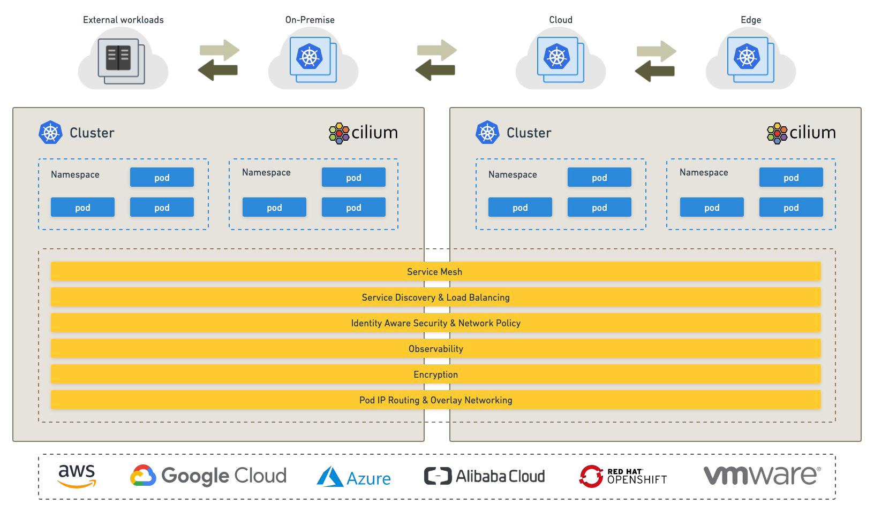
Cluster Mesh

Slide 25
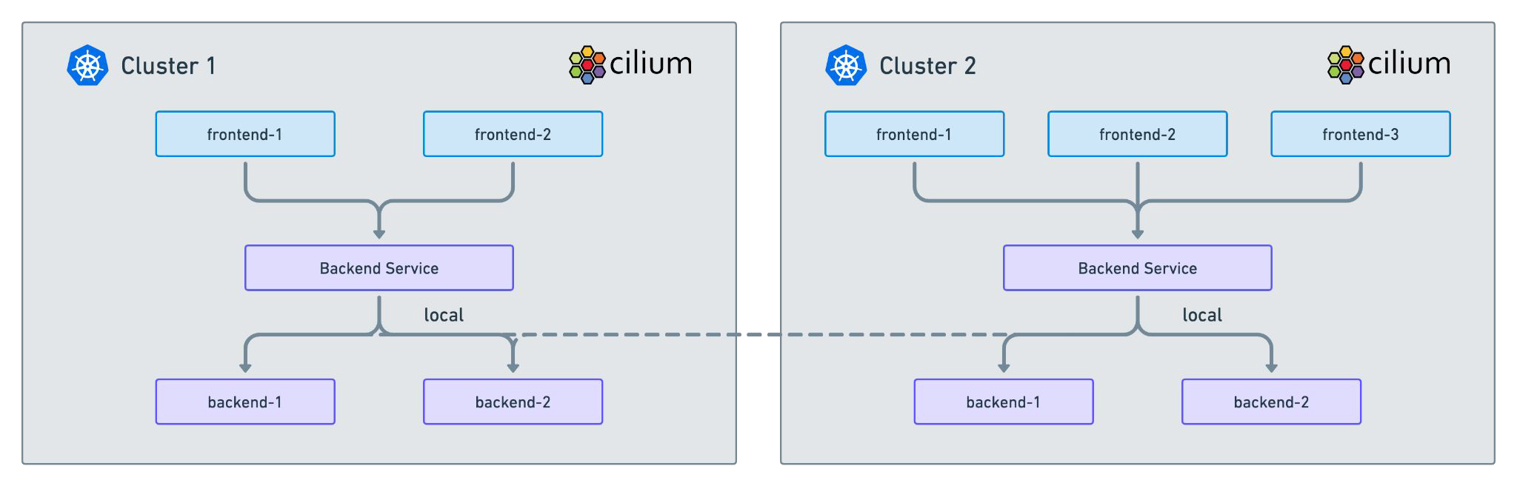
Cluster mesh - Local Service Affinity

Slide 26
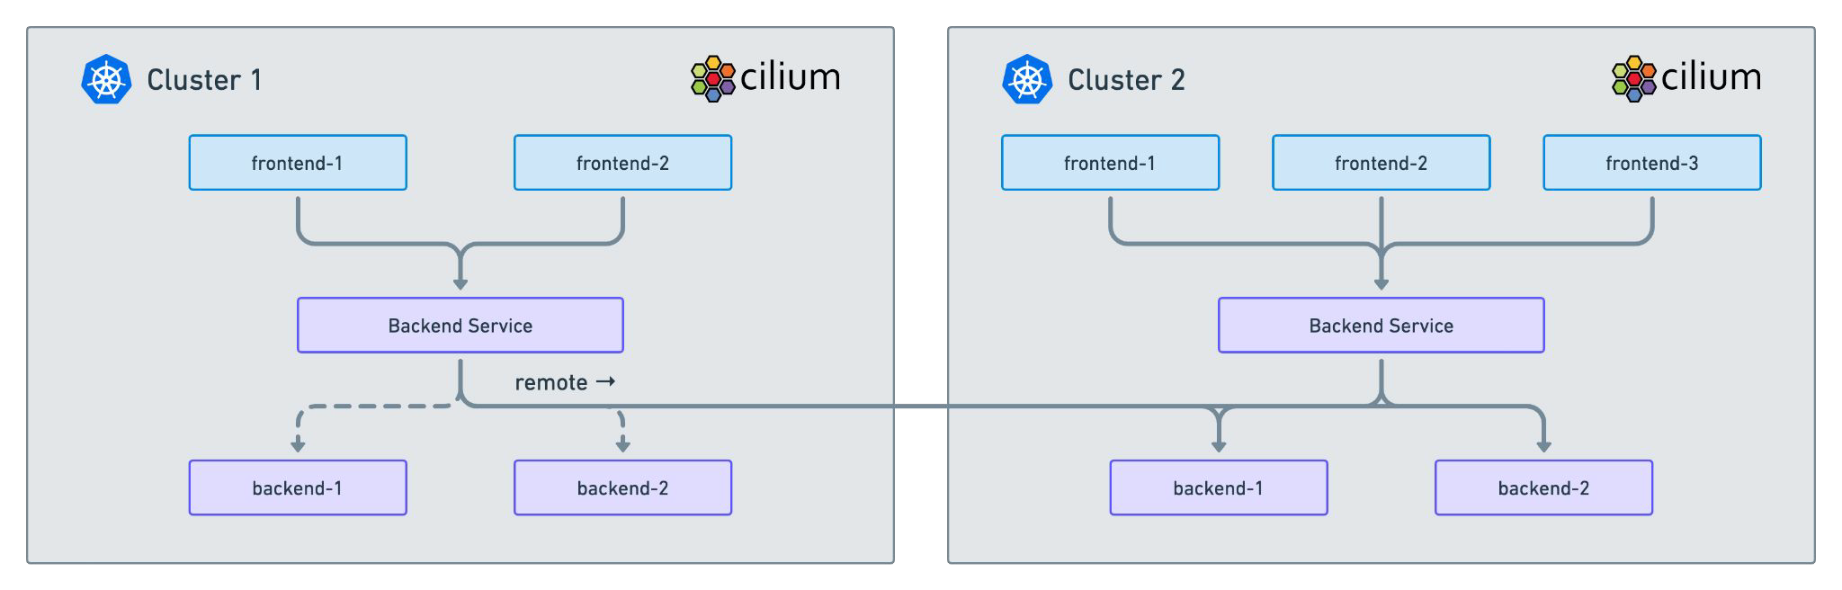
Cluster Mesh - Remote Service Affinity

Slide 27
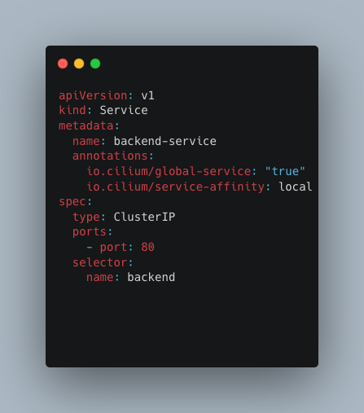
Cluster Mesh - Local Service Affinity

Slide 28
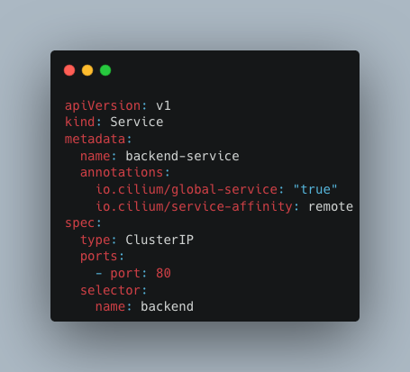
Cluster Mesh - Remote Service Affinity

Slide 29
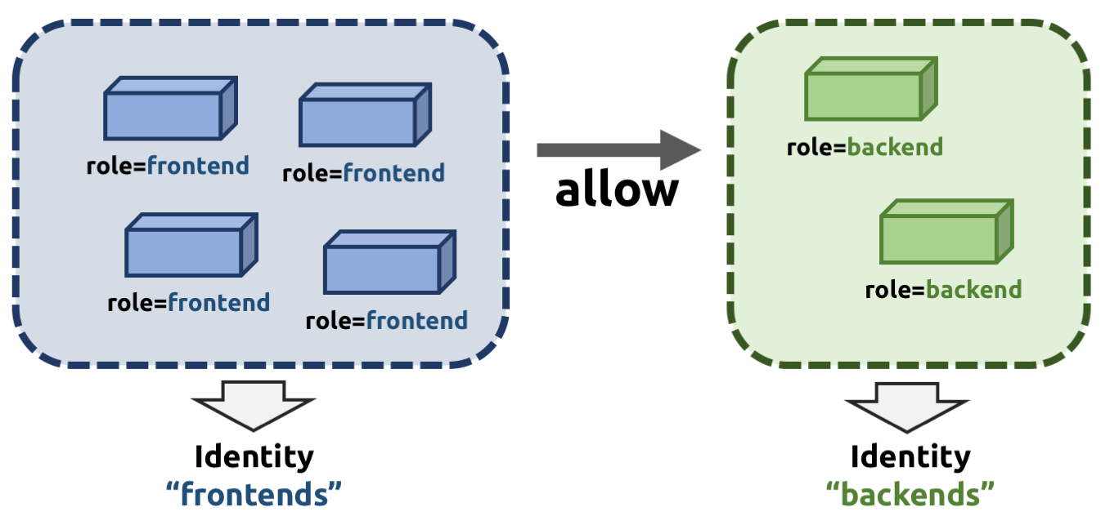
Identity-based Security

Slide 30
Cilium Network Policies
Cilium implements Kubernetes Network Policies for L3/L4 level and extends with L7 policies for fine grained API-level security for common protocols such as HTTP, Kafka, gRPC, etc

Slide 31
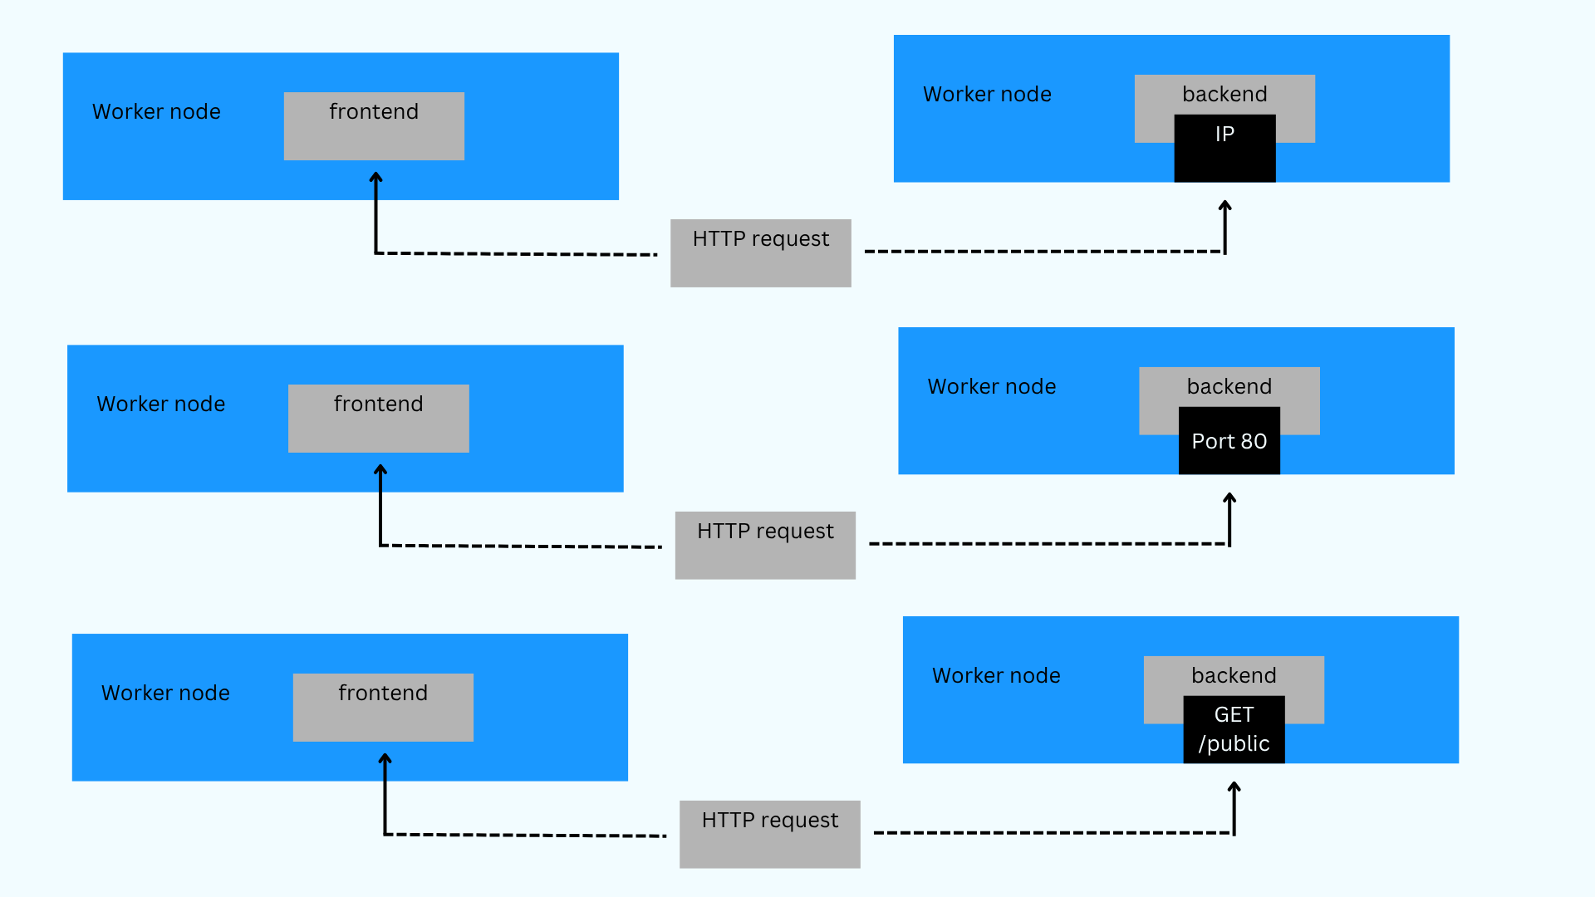

Slide 32
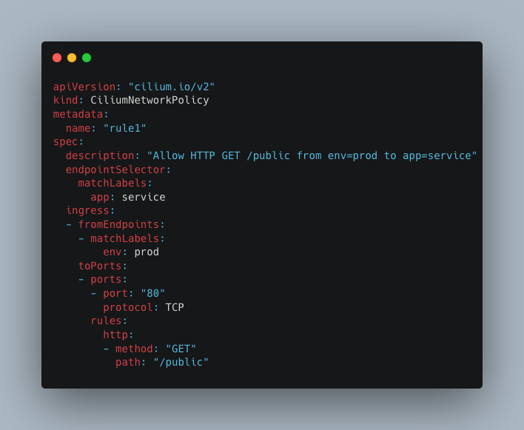
Cilium Network Policy example

Slide 33
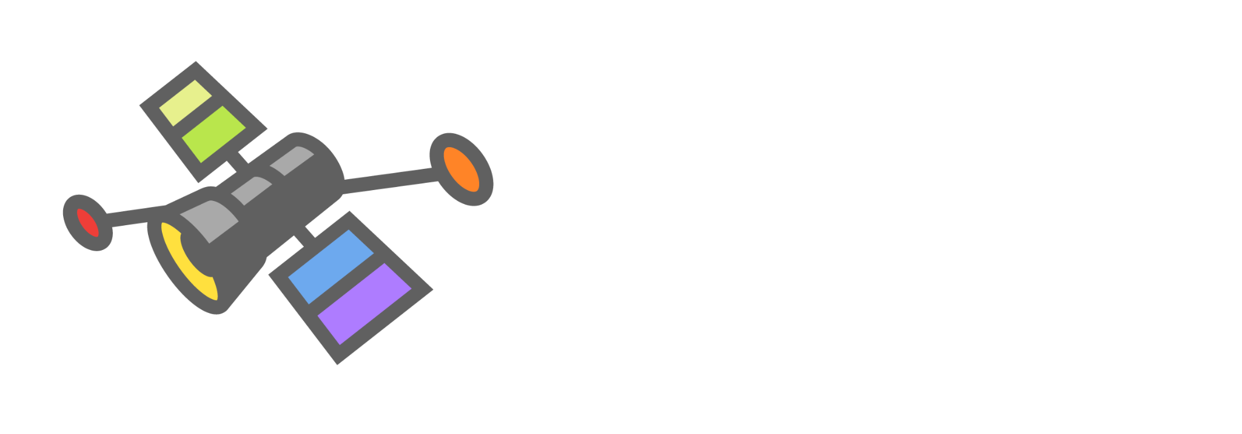
What is Hubble ?
Hubble UI
Service dependency maps
Flow display and filtering
Network Policy Viewer
Hubble CLI
Detailed Flow Visibility
Extensive Filtering
JSON output
Hubble Metrics
Build metrics for operations and application monitoring

Slide 34
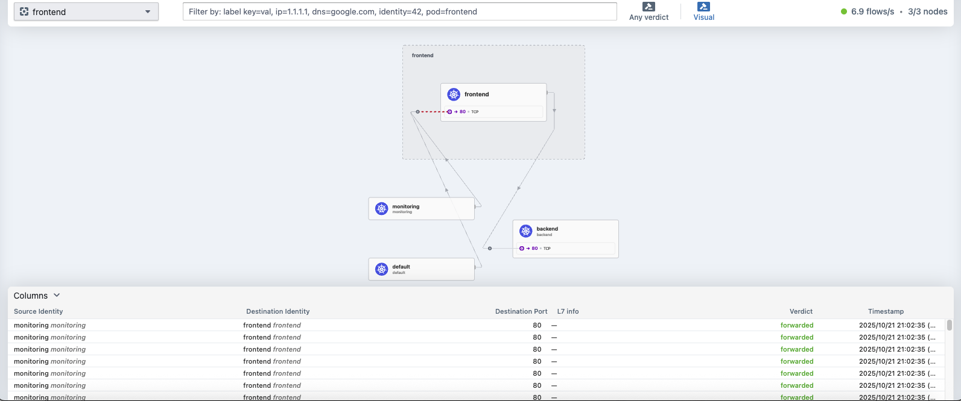
Service Map

Slide 35
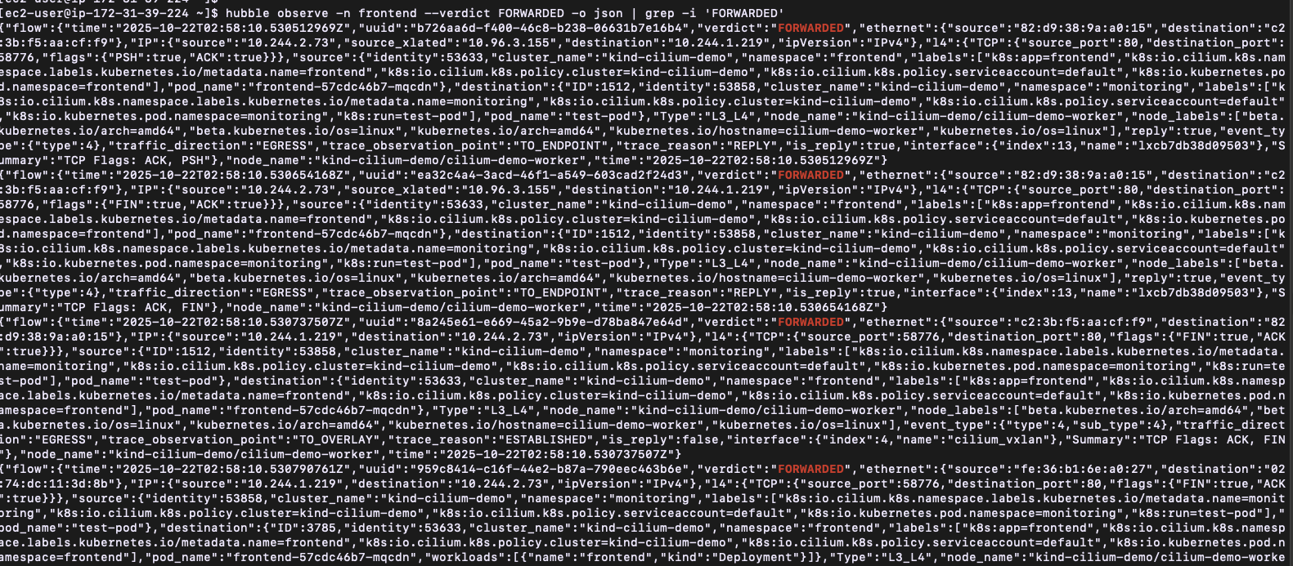
Flow visibility

Slide 36
Troubleshooting
Health Checklist
Check cilium daemonset and operator health
Check envoy if it is enabled
Cilium status or (cilium-dbg status) on a pod
Optionally run cilium connectivity test to validate baseline paths
Gather logs (agent and operator)
Grab current logs from agent and operator
Look for restarts/crashes, IPAM issues, kube-proxy replacement messages or runtime errors

Slide 37
Troubleshooting
3. Inspect config (configMap)
View live agent config and cluster configmap
4. Services and backeds
Verify kube-proxy replacement state and service maps
Confirm backends are registered and endpoints are healthy.

Slide 38
Troubleshooting
5. Watch traffic with cilium-dbg monitor
Run on the same node as the affected pod
FIlter event types: –type drop, policy verdict, trace
6. Collect a sysdump
Use cilium sysdump to capture cluster-wide diagnostics

Slide 39

Cilium Certified Associate (CCA)
The Cilium Certified Associate (CCA) exam confirms a user’s knowledge of connecting, securing, and observing Kubernetes clusters using Cilium.

Slide 40
H1 2026 KCDs
February
KCD Guadalajara – February (Tier 1)
March
KCD Panama – March (NEW)
July
KCD Lima, Perú – July (Tier 2)

Slide 41
Resources
eBPF - https://ebpf.io/
Cilium - https://cilium.io/
Isovalent labs - https://isovalent.com/labs/
Demo - https://github.com/abalso0/containers-days-2025-cilium-cheatsheet.git

Slide 42
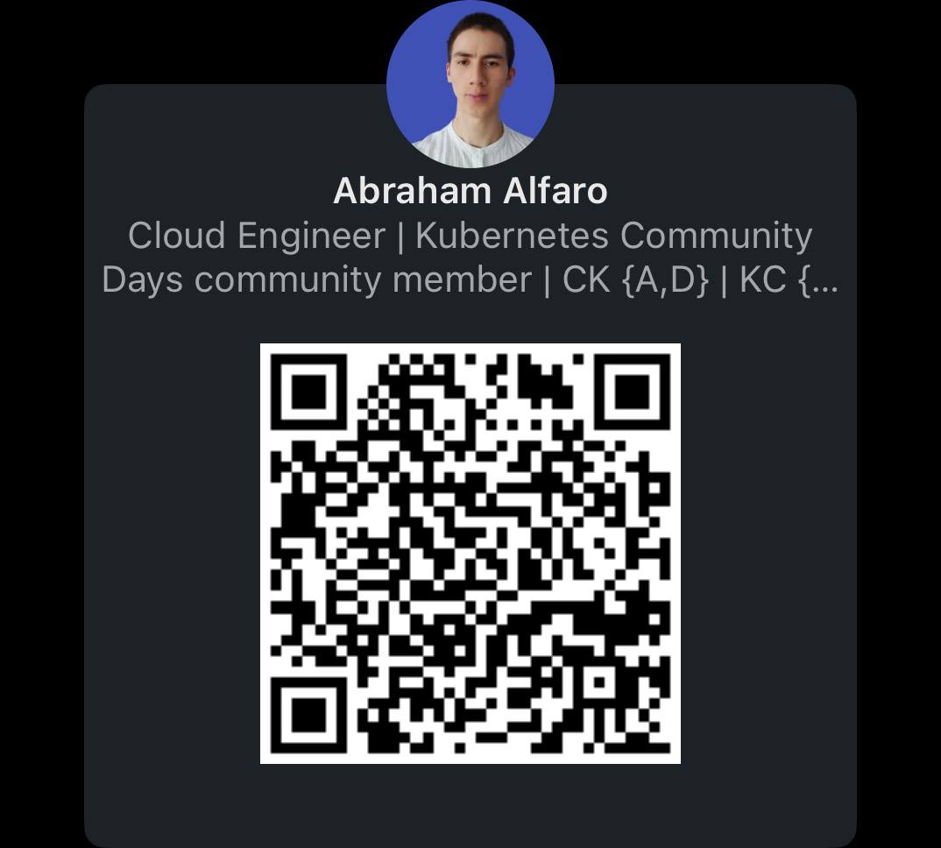
Thank you!
Abraham Alfaro | @abalso
Cloud Engineer @ AWS

